Slide 1
BCSE102L Structured and Object Oriented Programming
Dr.S.Sreethar
Associate Professor
School of Computer Science and Engineering
Cabin: PRP217[1]
Email: sreethar.s@vit.ac.in
+91 8220123102

Slide 2
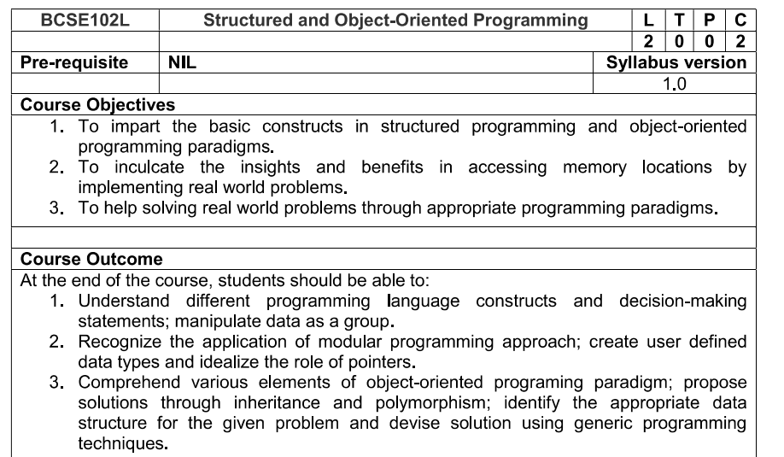

Slide 3
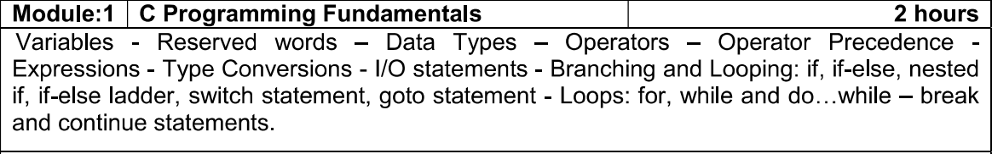

Slide 4
History of C
It is a most popular language.
Structured and machine independent language.
C was evolved from ALGOL -> CPL -> BCPL -> B -> C
Unix is one of the most popular network operating system and it was coded entirely in C

Slide 5












Who? When? Where? Why?
Who?
Dennis Ritche
Where?
AT & T’s Bell Laboratories of USA
When?
1972.
Why? C is reliable, friendly
What next?
C C++
Java
C++, Java => OOP

Slide 6
Why C is Middle Level Language ?
C Programming supports Inline Assembly Language Programs
Using inline assembly language feature in C, we can directly access system registers.
C Programming is used to access memory directly using pointer.
C Programming also Supports high Level Language Features.
It is more User friendly as compare to Previous languages, so C programming is Middle Level Language.

Slide 7
Why C is Middle Level Language ?
C is called middle-level language because it is actually bind the gap between a machine level language and high-level languages.
User can use c language to do System Programming (for writing operating system) as well as Application Programming (for generate menu driven customer billing system ).
That's why it is called middle level language.
High level - Ada , Modula-2 , Pascal, COBOL, FORTRAN, BASIC
Middle level - Java, C++, C, FORTH, Macro-assemble
Low level - Assembler

Slide 8
Features of C
General-purpose Structured language
Free format and case-sensitive language
System Programming language
Fast running and efficient language
Machine independent and hence it is portable
Supports limited data-types
Commands can be inserted anywhere in the program
Memory address are directly accessed by using pointers
Supports modularity
Permits recursion
More built-in functions

Slide 9
All the world is in “C”
OS – Windows / UNIX / LINUX
Device Drivers
Mobile Devices
Microprocessor in washing machine, digital camera, microwave oven
3D Computer Games - still written in C
C is the best when it comes to performance

Slide 10
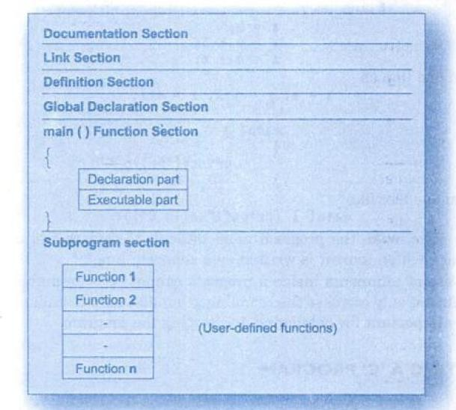
Structure of C Program

Slide 11
An Example C Program
main( )
{
printf(“Welcome to BCSE102L”);
}
// Function name
// Start of the program
// Program statements
// End of program
Output
Welcome to BCSE102L

Slide 12
Another Example
main( )
{
int number;
int amount;
number=100; amount = 50 + 40; printf(“%d”, number); printf(“%d”, amount);
}
Output
100
90
// Start of the program
// Declaration
// assignment statement
// printing the output
// End of program

Slide 13
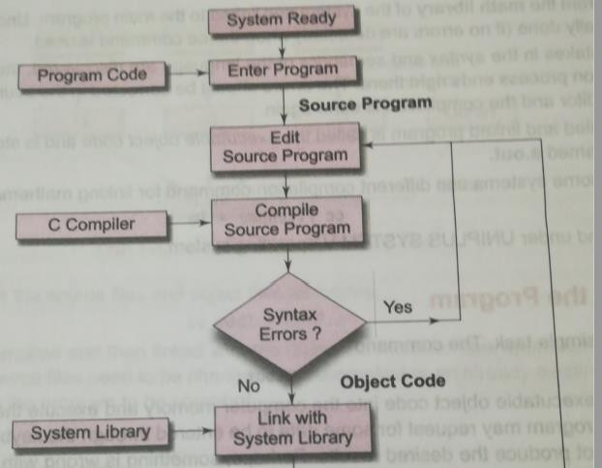
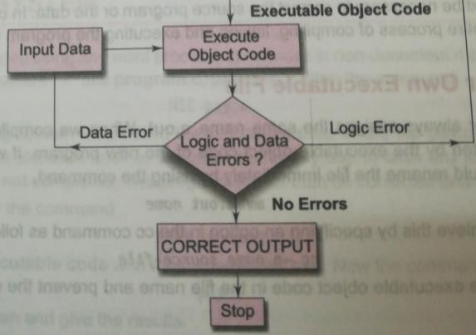
Execution Process

Slide 14
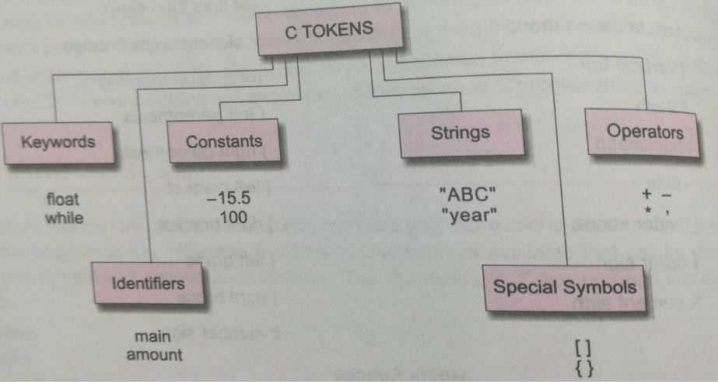
C Tokens

Slide 15
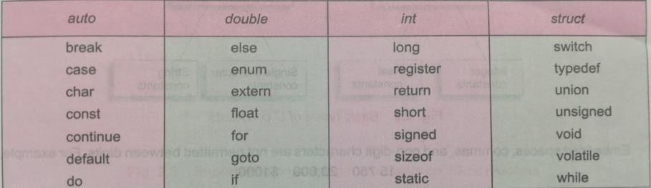
Keywords of ANSI C
Note: Keywords should not be used as Variable Names

Slide 16
Identifiers
Identifiers refer to names of variables, functions and arrays
These are user-defined names and consist of sequence of letters and digits Example: int sample;
Rules
First character should be an alphabet
Must contain only letters, digits or underscore
Only first 31 characters are significant
Cannot use a keyword
Must not contain White space

Slide 17
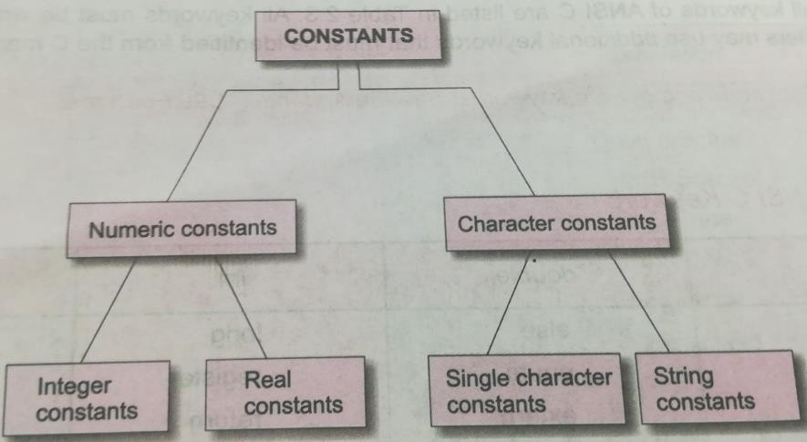
Constants
Constant hold fixed values that do not change during the execution of the program.

Slide 18
1. Integer Constant
An integer constant refers to a sequence of digits. Eg: 426, -8900
Rules
It must have at least one digit.
It must not have a decimal point.
It can be either positive or negative.
If no sign precedes an integer constant it is assumed to be positive.
No commas or blanks are allowed within an integer constant.
The allowable range for integer constants is -32768 to 32767.

Slide 19
Integer Constant
Three types:
Decimal integer – consists of set of digits, 0 through 9 (Eg. 129, -921, 0)
Octal integers - consists of set of digits, 0 through 7 with a leading 0. (Eg. 0123, 051)
Hexadecimal integers - consists of set of digits, 0 through 9 and A through F. Digits are preceded by 0x or 0X (Eg. 0x123, 0Xbcd, 0X9F)

Slide 20
2. Floating Point or Real Constant
Integers are inadequate to represent quantities that can vary continuously such as distances, heights, temperatures, prices, etc.
These quantities are represented by numbers containing fractional parts like 15.234
Rules
It must have at least one digit.
It must have a decimal point.
It could be either positive or negative.
Default sign is positive.
No commas or blanks are allowed within a real constant.

Slide 21
3. Character Constant
It is a single alphabet, a single digit or a single special symbol enclosed within single inverted commas.
The maximum length of a character constant can be 1 character. Eg: ‘A’ ‘5’ ‘%’
Character constant have integer values known as ASCII values. Eg. The ASCII value of the letter a is 97
So,
printf(“%d”, ‘a’) -> would print number 97 printf(“%c”, ’97’) - > would print letter ‘a’

Slide 22
4. String Constant
It is a sequence of characters enclosed in double quotes.
The characters may be letters, numbers, special characters and blank space.
Eg: “Computer” “Computer Science” “2022”

Slide 23
Variables in C
A variable is a data name used to store a data value
It may take different values at different times during the execution
Rules
Must begin with a letter
It may consists of letters, digits and underscore
ANSI recognises a length of 31 characters but most compilers recognize only 8 characters
Case sensitive
It should not be keyword
White space is not allowed

Slide 24
Variables in C
A variable is a data name used to store a data value
It may take different values at different times during the execution
Rules
Must begin with a letter
It may consists of letters, digits and underscore
ANSI recognises a length of 31 characters but most compilers recognize only 8 characters
Case sensitive
It should not be keyword
White space is not allowed

Slide 25
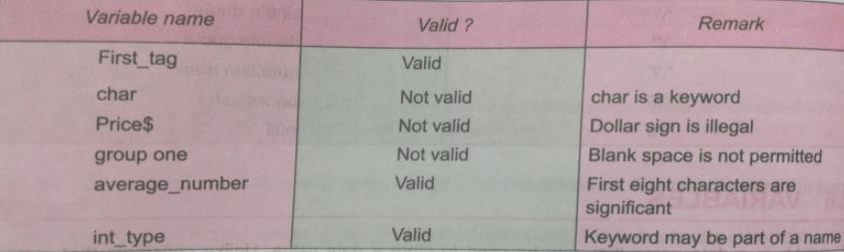
Variables in C
Examples

Slide 26
Declaration and initialization of Variables
Syntax: data-type variable_name;
int student_marks; → Declaring float s1, s2, s3;
int student_marks = 48; → assigning a value

Slide 27
Data types in C
ANSI C supports three classes of datatypes.
Primary data types
Derived data types
User-defined data types
Primary data types
Supports five fundamental data types
Integer (int), Character (char), floating point (float), double-precision floating point (double) and void

Slide 28
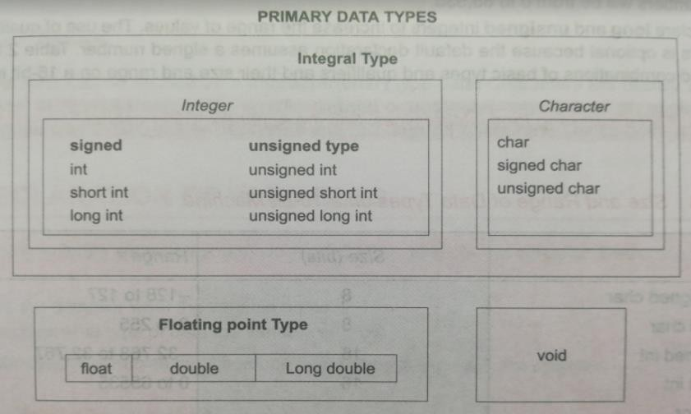
Data types in C
Primary data types

Slide 29
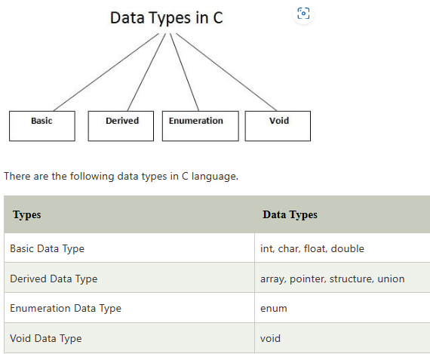

Slide 30
Get the Exact Size of Any Data Type in C
#include <stdio.h>
int main()
{
printf("'int' storage size = %d\n", sizeof(int));
return 0;
}

Slide 31
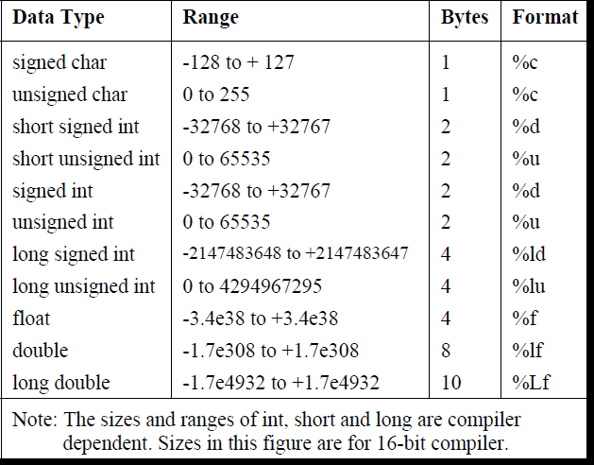
Primary Data Types

Slide 32
Defining Symbolic Constants
A constant value can be assigned to these names at the beginning of the program
Syntax: #define Symbolic-name value-of-constant
Example:
#define STRENGTH 100
#define PASSMARK 50

Slide 33
#include<stdio.h>
void main()
{
void print();
print();
}
void print()
{
printf("Welcome");
}

Slide 34
//Swap Numbers Without Using Temporary Variables
#include <stdio.h>
int main() {
double a, b;
printf("Enter a: ");
scanf("%lf", &a);
printf("Enter b: ");
scanf("%lf", &b);
a = a - b;
b = a + b;
a = b - a;
// %.2lf displays numbers up to 2 decimal places
printf("After swapping, a = %.2lf\n", a);
printf("After swapping, b = %.2lf", b);
return 0;
}

